Slide 1



Code by Cooking 0.0
Team Member(s): Derrick Serbia, Dhrumel Shah Product Owner(s): Franciso Ortega
Mentor(s): Franciso Ortega, Mohsen Taheri
Instructor: Masoud Sadjadi School of Computing and Information Sciences Florida International University
Final Presentation
<Fall 2016>
Notes:
7 seconds.
Greet your audience, thank them for attending your presentation, introduce yourself, introduce your project, introduce your team members, and quickly indicate what each of you did in a high-level manner, and put more emphasis on your part/contribution.

Slide 2
Project definition
Code by Cooking teaches basic programming concepts using a distinctive, engaging approach.
Current Systems:
Books
Lectures
Videos
Examples
Cannot related concepts with other activities
Notes:
10 seconds.
Introduce the problem that the whole project (in all versions) tackles with GIF or screenshot.

Slide 3
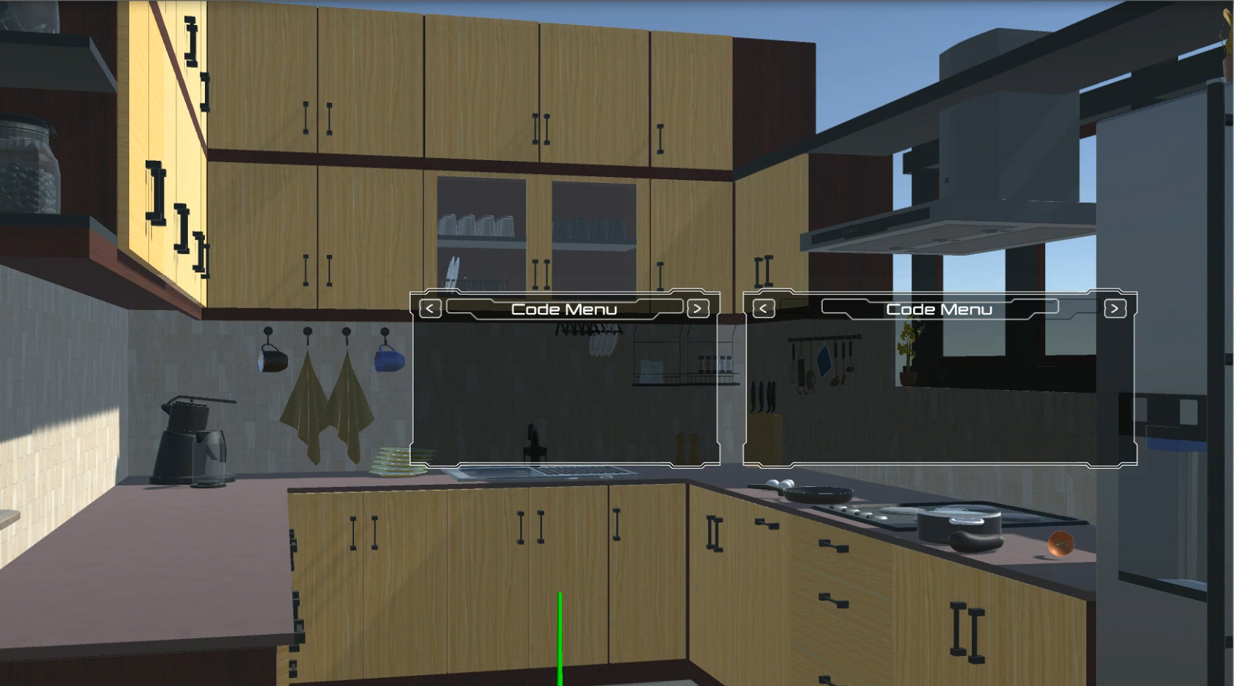
Project definition
Notes:
20 seconds.
Introduce the problem that the your project (in new version) tackles with GIF or screenshot.

Slide 4
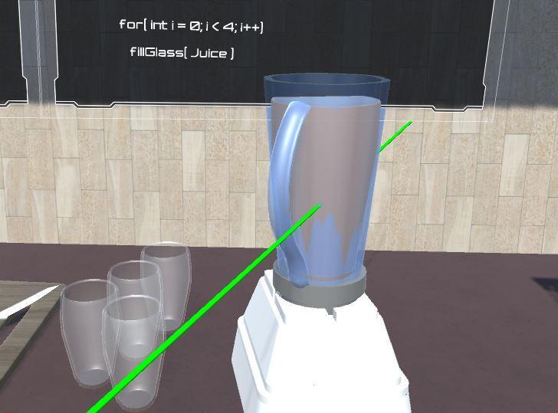
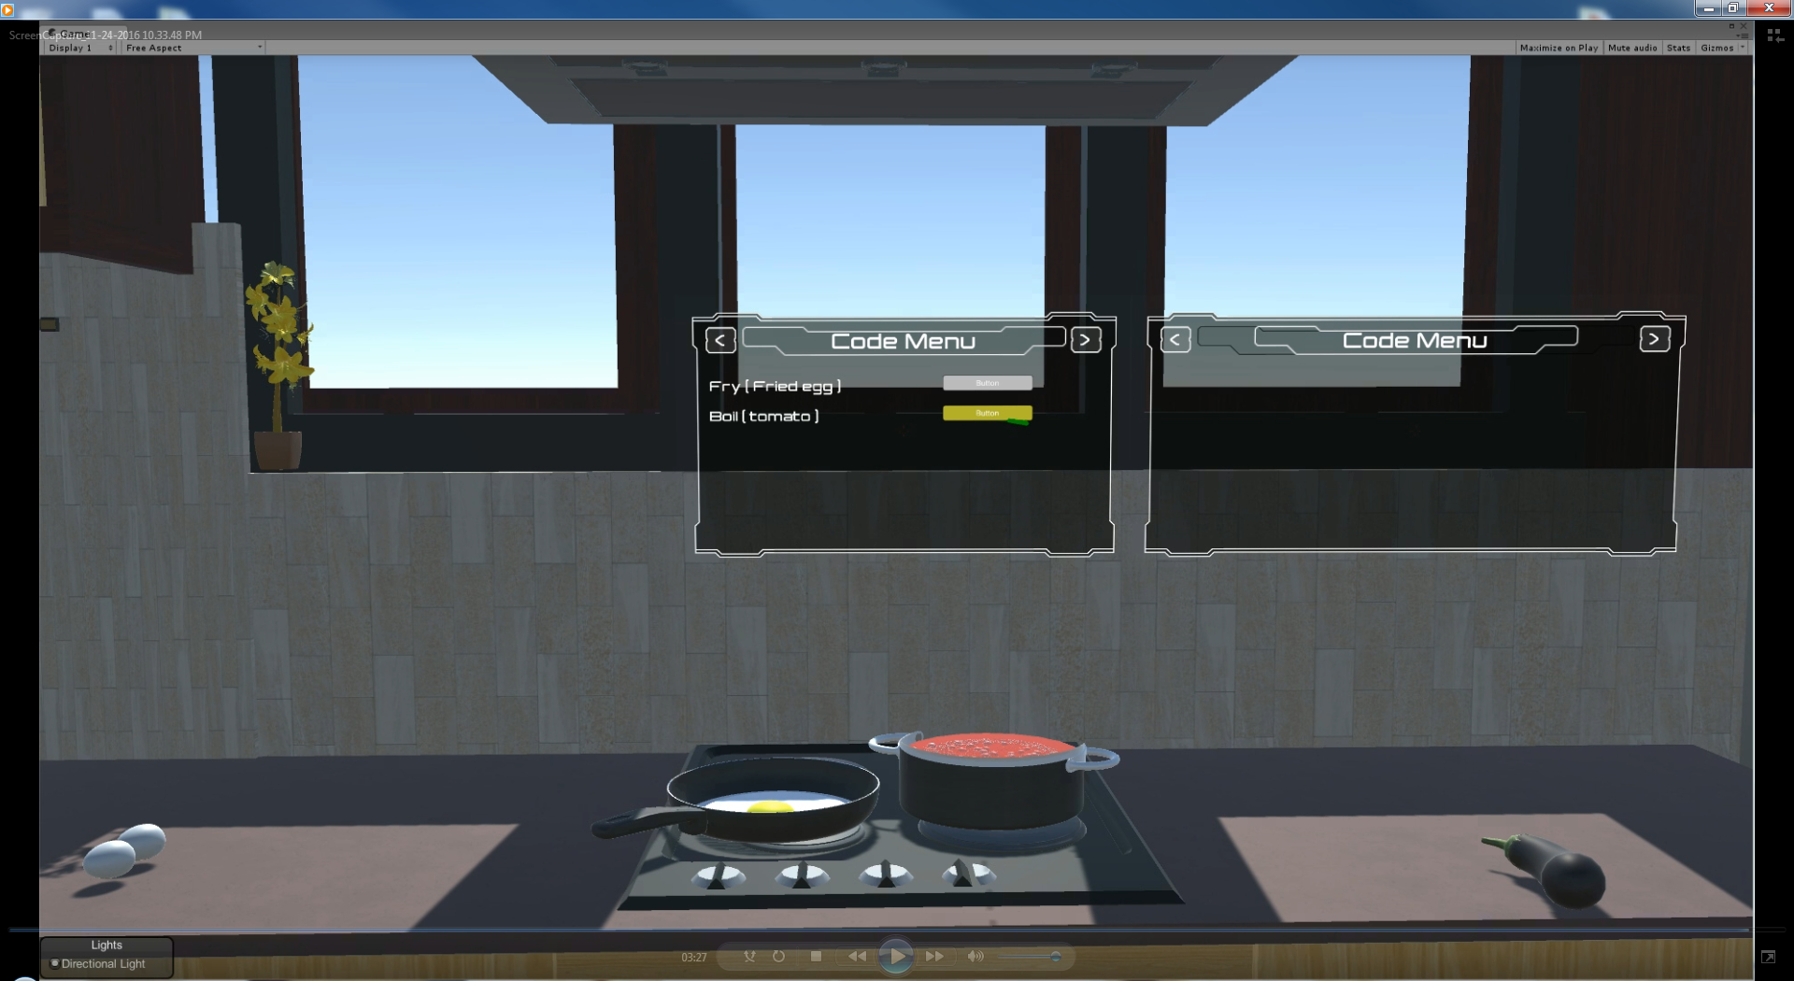
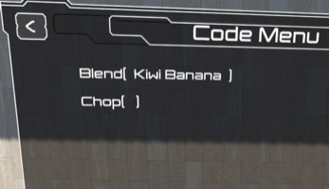
Project definition
Notes:
20 seconds.
Introduce the problem that the your project (in new version) tackles with GIF or screenshot.

Slide 5
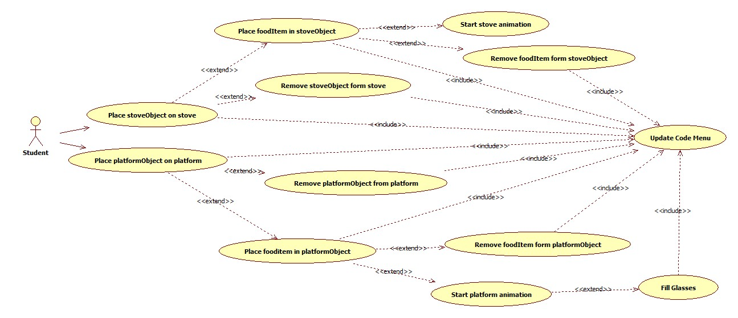
Requirements: Use Cases
Notes:
5 seconds
Show the Use Case Diagram for the whole project. Highlight your use cases.

Slide 6
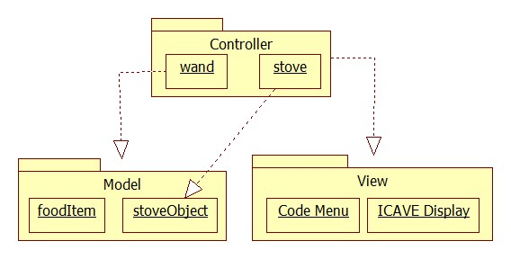
System Design: Architecture
Model-View-Controller
Notes:
20 seconds
System design: Highlight the parts that you contributed to them.
1. System decomposition; identify the architecture patterns used
2. System deployment – h/w and s/w requirements

Slide 7
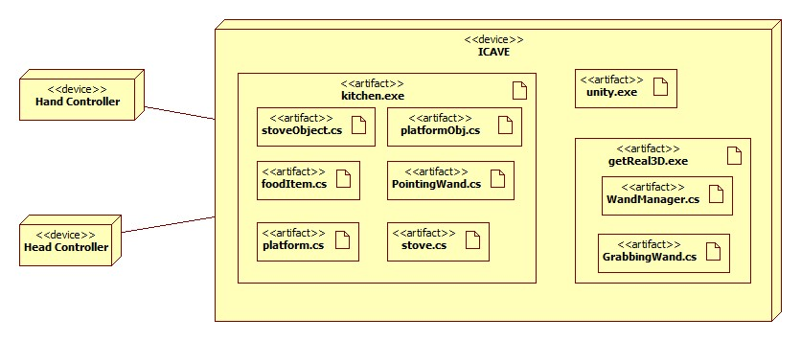
System Design: Architecture
Deployment Diagram
Notes:
20 seconds
System design: Highlight the parts that you contributed to them.
1. System decomposition; identify the architecture patterns used
2. System deployment – h/w and s/w requirements

Slide 8
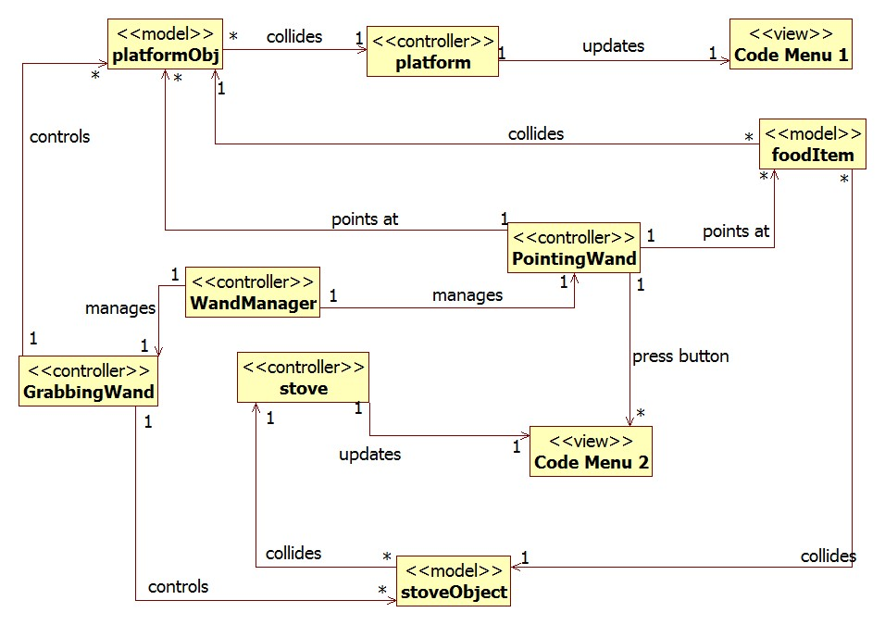
Minimal Class Diagram
Notes:
10 seconds.Minimal class diagram. Highlight the classes that you created/modified
Identify the design patterns used (one or more slides).

Slide 9
User Stories
User Story #1087 - See object/parameter that the function is using
User Story #1081 - View pseudo-code for all functionalities
User Story #1112 - View cooking process/output
User Story #1114 - View looping functionality
User Story #1109 - Add button to begin animations
Notes:
5 seconds.
List the user stories that you worked on them.(put in order of importance). Stay focused on the parts that you have been working.

Slide 10
User Story #1087 - See object/parameter that the function is using
Description: As as user, I would like the in-game screen to also display the object that the function is using. That way, I will know that the function is doing work on an object.
What does this mean?
Update text from Boil(objectToCook) to Boil(tomato)
Notes:
60 seconds
The tile of user story
The most important user story you worked on it. You have to describe this one very well and be proud of that.
Please present and show the complexity of your work, code, algorithms, and technical challenges and technologies you have used. (you could use screenshot if you want. Visual presentations are better than text presentation)
Go into the details of the most important/significant tasks using bullet lists or visual graphs or state chart diagram
Sequence Diagram for this user story is mandatory (in another separate page if required)
Demo using screenshots or GIF (in another separate page if required)

Slide 11
User Story #1087 - See object/parameter that the function is using
Why is this important?
Three scripts interacting with each other.
Information is being accessed indirectly through a “middle-man”.
Scripts constantly checking for contact and interaction between objects in order to update correctly
Notes:
60 seconds
The tile of user story
The most important user story you worked on it. You have to describe this one very well and be proud of that.
Please present and show the complexity of your work, code, algorithms, and technical challenges and technologies you have used. (you could use screenshot if you want. Visual presentations are better than text presentation)
Go into the details of the most important/significant tasks using bullet lists or visual graphs or state chart diagram
Sequence Diagram for this user story is mandatory (in another separate page if required)
Demo using screenshots or GIF (in another separate page if required)

Slide 12
User Story #1087 - See object/parameter that the function is using
Procedure:
stove.cs detects that an object has entered its trigger.
check if the item is a StoveObject and, if so, check if it is already colliding with the stove.
If it’s not colliding, call the function activateButton, which takes an int and a foodItem.
assignText finds the first empty line in our Code Menu and returns its position as an int.
Pass this int and a the foodItem that is on the stoveObject as the parameters for activateButton.
This will make the line of text display code and button appear and will give functionality to the button.
Notes:
60 seconds
The tile of user story
The most important user story you worked on it. You have to describe this one very well and be proud of that.
Please present and show the complexity of your work, code, algorithms, and technical challenges and technologies you have used. (you could use screenshot if you want. Visual presentations are better than text presentation)
Go into the details of the most important/significant tasks using bullet lists or visual graphs or state chart diagram
Sequence Diagram for this user story is mandatory (in another separate page if required)
Demo using screenshots or GIF (in another separate page if required)

Slide 13
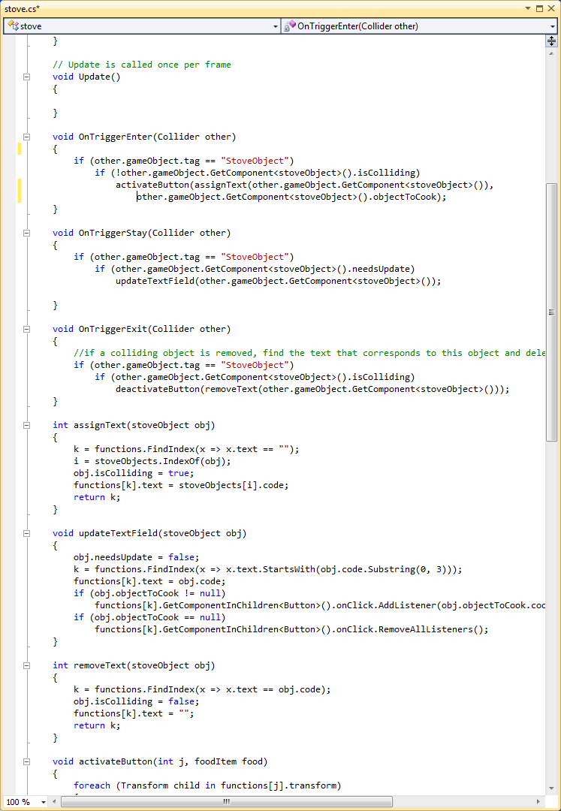
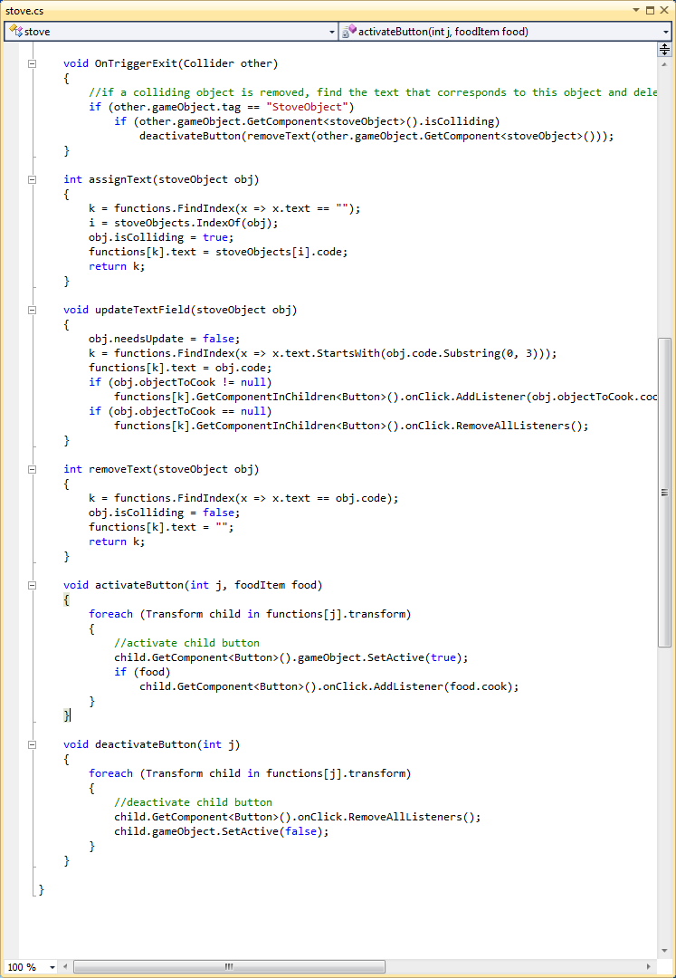
User Story #1087 - See object/parameter that the function is using
Notes:
60 seconds
The tile of user story
The most important user story you worked on it. You have to describe this one very well and be proud of that.
Please present and show the complexity of your work, code, algorithms, and technical challenges and technologies you have used. (you could use screenshot if you want. Visual presentations are better than text presentation)
Go into the details of the most important/significant tasks using bullet lists or visual graphs or state chart diagram
Sequence Diagram for this user story is mandatory (in another separate page if required)
Demo using screenshots or GIF (in another separate page if required)

Slide 14
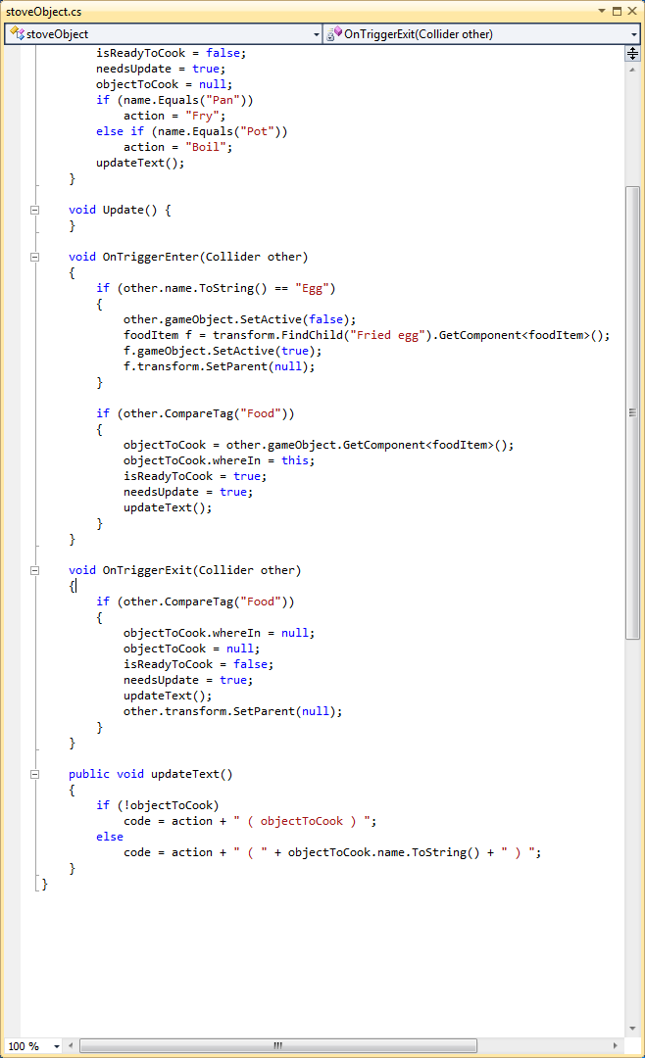
User Story #1087 - See object/parameter that the function is using
Notes:
60 seconds
The tile of user story
The most important user story you worked on it. You have to describe this one very well and be proud of that.
Please present and show the complexity of your work, code, algorithms, and technical challenges and technologies you have used. (you could use screenshot if you want. Visual presentations are better than text presentation)
Go into the details of the most important/significant tasks using bullet lists or visual graphs or state chart diagram
Sequence Diagram for this user story is mandatory (in another separate page if required)
Demo using screenshots or GIF (in another separate page if required)

Slide 15
User Story #1087 - See object/parameter that the function is using
Challenges:
Passing correct information from foodItem.cs to stoveObject.cs to stove.cs in order to update the Text field
Multiple collision points created conflict in the scripts
Notes:
60 seconds
The tile of user story
The most important user story you worked on it. You have to describe this one very well and be proud of that.
Please present and show the complexity of your work, code, algorithms, and technical challenges and technologies you have used. (you could use screenshot if you want. Visual presentations are better than text presentation)
Go into the details of the most important/significant tasks using bullet lists or visual graphs or state chart diagram
Sequence Diagram for this user story is mandatory (in another separate page if required)
Demo using screenshots or GIF (in another separate page if required)

Slide 16
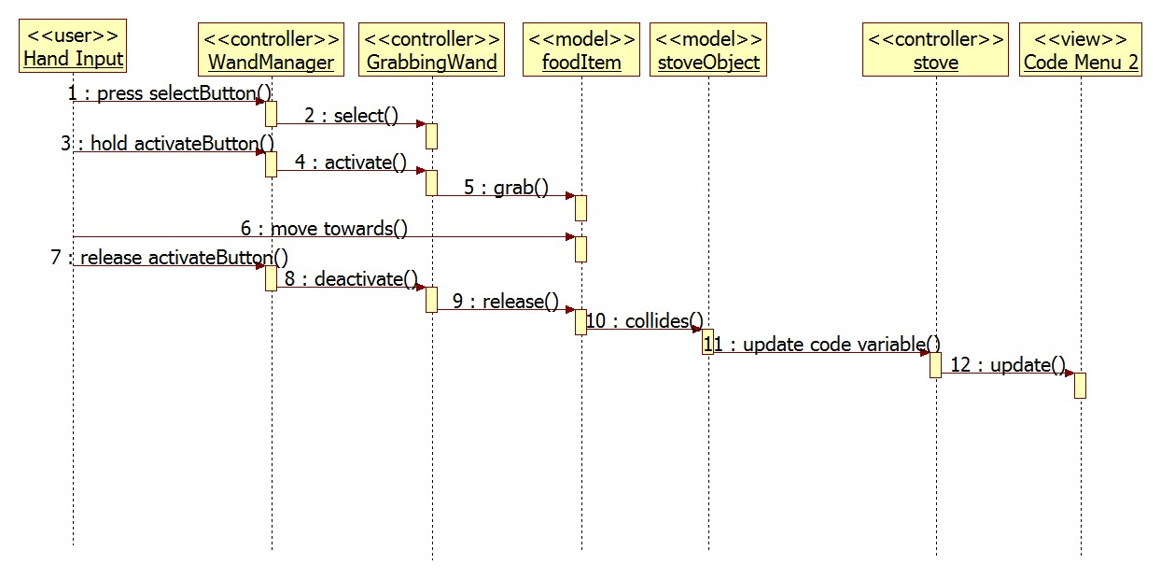
User Story #1087 - See object/parameter that the function is using
Notes:
60 seconds
The tile of user story
The most important user story you worked on it. You have to describe this one very well and be proud of that.
Please present and show the complexity of your work, code, algorithms, and technical challenges and technologies you have used. (you could use screenshot if you want. Visual presentations are better than text presentation)
Go into the details of the most important/significant tasks using bullet lists or visual graphs or state chart diagram
Sequence Diagram for this user story is mandatory (in another separate page if required)
Demo using screenshots or GIF (in another separate page if required)

Slide 17
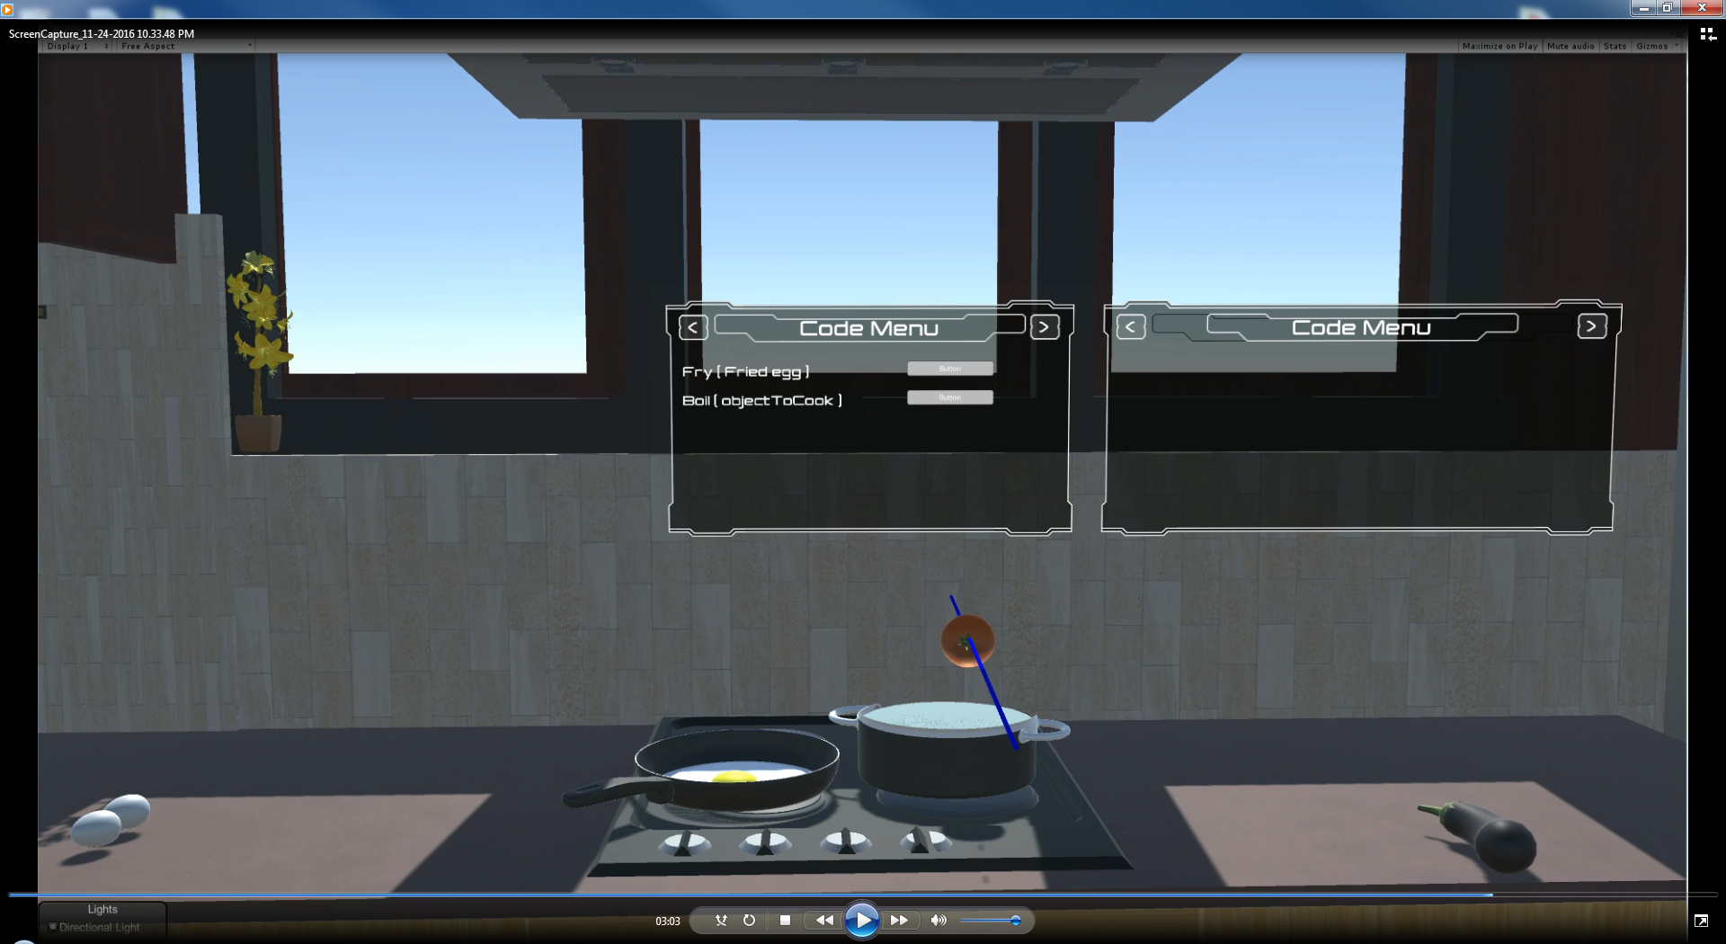
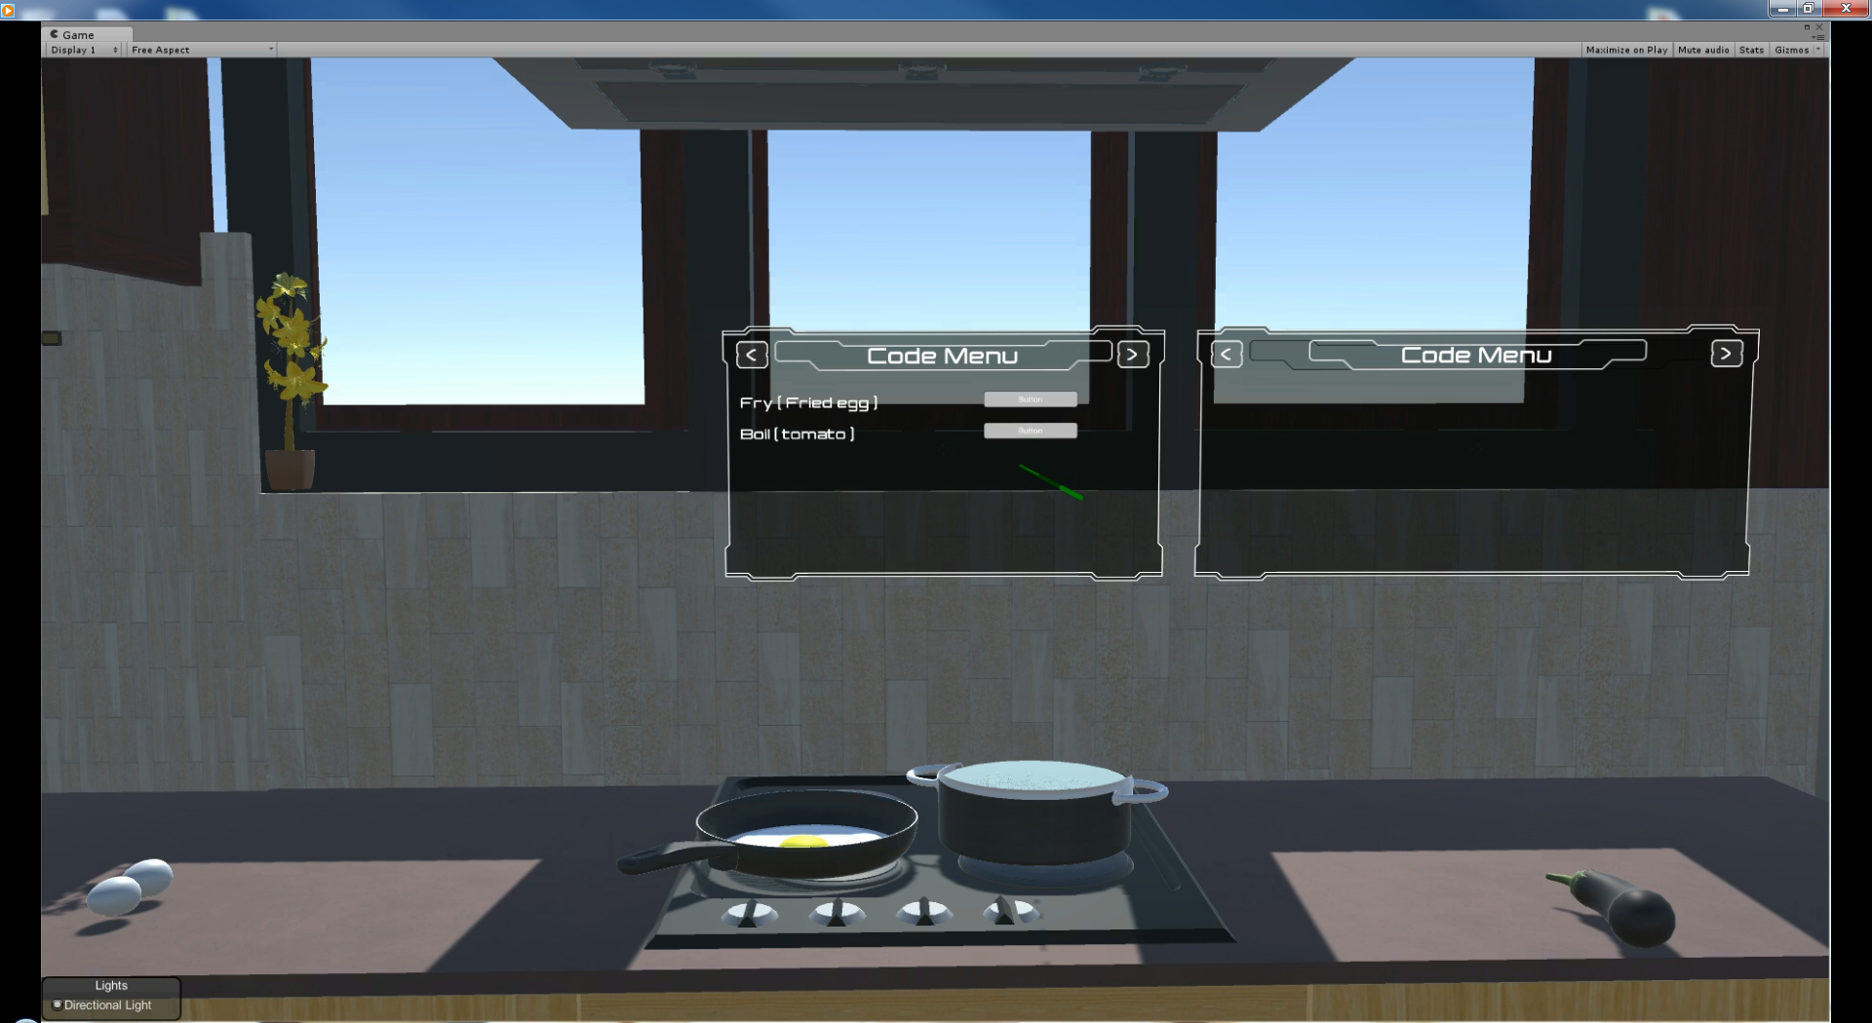
User Story #1087 - See object/parameter that the function is using
Notes:
60 seconds
The tile of user story
The most important user story you worked on it. You have to describe this one very well and be proud of that.
Please present and show the complexity of your work, code, algorithms, and technical challenges and technologies you have used. (you could use screenshot if you want. Visual presentations are better than text presentation)
Go into the details of the most important/significant tasks using bullet lists or visual graphs or state chart diagram
Sequence Diagram for this user story is mandatory (in another separate page if required)
Demo using screenshots or GIF (in another separate page if required)

Slide 18
User Story #1081 - View pseudo-code for all functionalities (PlatformObject)
Description: As a student user, I want to be able to view the pseudo-code on the screen for all the functions I carry out with Platform Objects (blender, chopper) so that I understand how the code is implemented for each function.
What does this mean?
Update text from chop() to chop(chicken) when chicken is placed on the chopping board
Update text back to chop() when chicken is removed
Remove entire text when chopping board is removed from platform
Notes:
20 seconds
The tile of user story
Please present and show the complexity of your work, code, algorithms, and technical challenges and technologies you have used. (you could use screenshot if you want. Visual presentations are better than text presentation) - Go into the details of the most important/significant tasks using bullet lists or visual graphs or state chart diagram - Demo using screenshots or GIF (in another separate page if required)
Sequence Diagram for this user story is optional

Slide 19
User Story #1081 - View pseudo-code for all functionalities (PlatformObject)
Interaction of scripts
Platform.cs - This script is attached to the kitchen platform. It serves as the controller and mediator between the PlatformObjects and the Code Menu. It updates when the PlatformObjects collide or stop colliding with it. It also uses the food attribute of the PlatformObject to update the display. Code segments for this script are shown in the next slide.
PlatformObject.cs - This script is attached to the chopping board. It has an attribute named food which updates when food enters and exits the chopping board. It provides functionality for multiple food items. The code for this script is relatively straightforward.

Slide 20
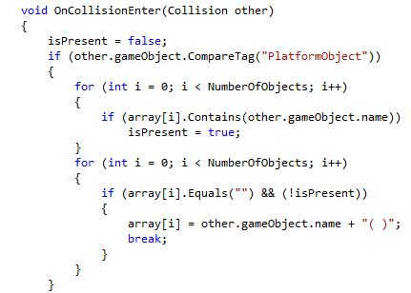
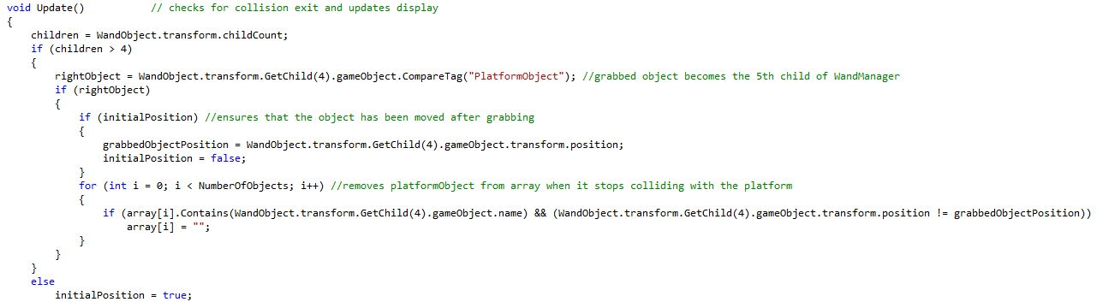
User Story #1081 - View pseudo-code for all functionalities (PlatformObject)
The OnCollisionEnter(Collision other) function on the right is called as soon as an object collides with it. The colliding object is passed as parameter to the function, and its tag is then checked in the code. We also check if the Code Menu (array[]) does not already contain the object. If the text position is also empty, then the display stores the object name.
The Update() function below is called every frame and checks whether the object has been grabbed by the wand and moved from its position, in which case, it no longer collides and is removed from the Code Menu.

Slide 21
User Story #1081 - View pseudo-code for all functionalities (PlatformObject)
Challenges:
Due to multiple colliders on one object, chop() was displaying twice on colliding with the platform. This was avoided by using the isPresent boolean variable.
The Grabbing Wand makes the grabbed object its child, hence, it does not allow Unity’s OnCollisionExit() function to work. For this reason, the collision exit of the PlatformObject had to be checked every frame in the Update() function. This was done by checking if the wand moves the object out of position. When moved out of current position, the object will always re-enter the collision even if it remains on the platform.

Slide 22
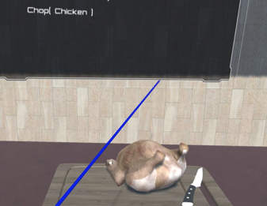
User Story #1081 - View pseudo-code for all functionalities (PlatformObject)
CodeMenu updates when chicken is placed on the chopping board
Notes:
20 seconds
The tile of user story
Please present and show the complexity of your work, code, algorithms, and technical challenges and technologies you have used. (you could use screenshot if you want. Visual presentations are better than text presentation) - Go into the details of the most important/significant tasks using bullet lists or visual graphs or state chart diagram - Demo using screenshots or GIF (in another separate page if required)
Sequence Diagram for this user story is optional

Slide 23
User Story #1112 - View cooking process/output
Description: As a student user, I want to be able to view the cooking process and output so I can get a complete cooking experience
What does this mean?
When the user points at the PlatformObject or the FoodItem on it with the pointing wand and presses the activate button, the cooking process should begin. For the chopping board, it will chop the chicken, potato or cheese into pieces. It basically calls the time waiting function and replaces the whole object with its pieces.
Notes:
20 seconds
The tile of user story
Please present and show the complexity of your work, code, algorithms, and technical challenges and technologies you have used. (you could use screenshot if you want. Visual presentations are better than text presentation) - Go into the details of the most important/significant tasks using bullet lists or visual graphs or state chart diagram - Demo using screenshots or GIF (in another separate page if required)
Sequence Diagram for this user story is optional

Slide 24
User Story #1112 - View cooking process/output
Interaction of scripts
PointingWand.cs - This script is attached to the Pointing Wand. It simply stores the name of the object it points to.
PlatformObject.cs - Attached to the blender and chopping board
Platform.cs - This script instantiates the PointingWand object and finds the name of the object being pointed to. If its name is that of the chopping board or any unchopped food item placed on it, the chopping process begins.

Slide 25
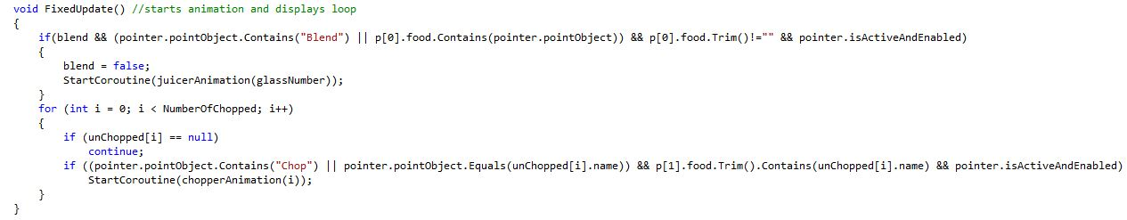
User Story #1112 - View cooking process/output
The FixedUpdate() function above is used to start the chopping and blending process. For the chopping process, it first iterates through the array to check for any unchopped items, and compares the name of those items to the name of the object pointed to by the pointing wand. It also checks if the pointed object is the chopping board itself, giving the user two options to start the process. The if statement also ensures that the food item is currently placed on the chopping board and the pointing wand is active.

Slide 26
User Story #1112 - View cooking process/output
Challenges:
The PointingWand.cs script was originally part of the GetReal3D plugin, but it had to be modified so that it would store the name of the object it points to. Without the modification, it would not be possible to use the wand to start the cooking process.
The Pointing Wand did not always respond immediately when the Activate button was pressed. I had to alter the colliders on each object to increase the area of contact.

Slide 27
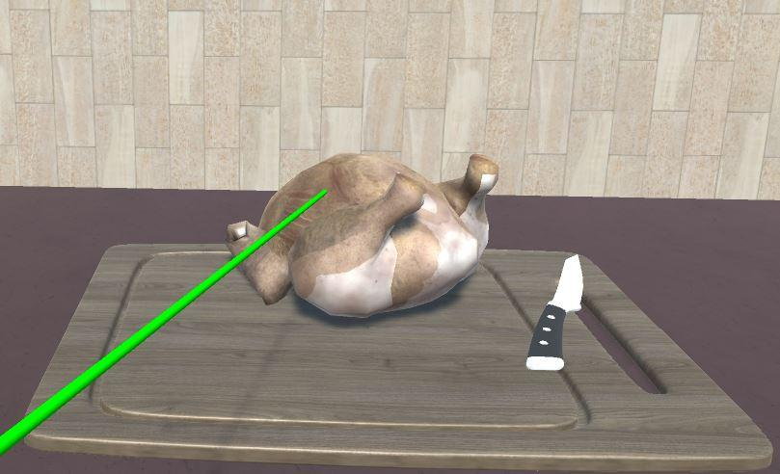
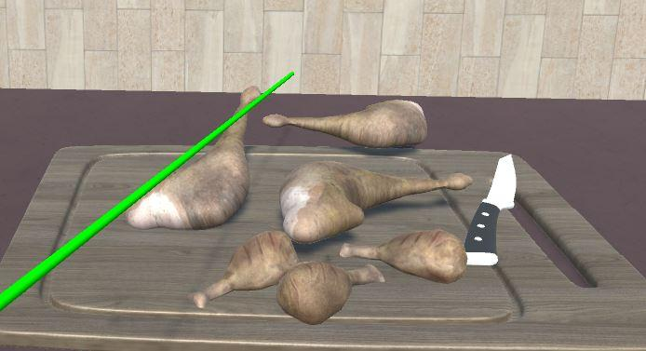
User Story #1112 - View cooking process/output
Pointing wand is used to point at the chicken and the Activate wand button is pressed
The chopping process is carried out and the unchopped chicken is replaced with the chopped chicken pieces

Slide 28
User Story #1114 - View looping functionality
Description: As a student user, I want to be able to view multiple outputs for the same function so that I can understand how loops are used in programming
What does this mean?
When the user points at the blender with the pointing wand and presses the activate button, the blending process begins, as long as the blender is colliding with the platform and fruits are present in it. The fruits are then replaced with juice. Prior to the blending process, the user has an option to place a certain number of glasses on the platform so that a loop will run to fill each glass with juice once the blending has been completed.

Slide 29
User Story #1114 - View looping functionality
Important scripts
Platform.cs - The script counts the number of glasses that collides with it, and once the blending process is completed, it executes a for loop that runs as many times as the number of glasses and executes the function fillGlass(glassIndex,juice) on each iteration. This is displayed on the Code Menu. The juice in each glass is activated one at a time, and an equivalent amount of juice is emptied from the blender.

Slide 30
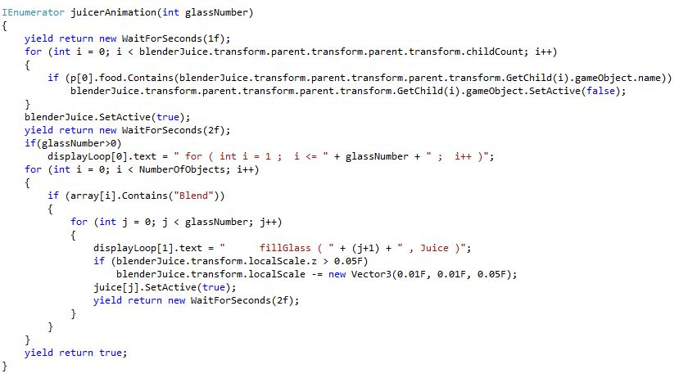
User Story #1114 - View looping functionality
To count the number of glasses, the script navigates through the hierarchy of gameObjects. These glasses, when placed on the platform, all become children of the blender. The fruits in the blender then deactivate, followed by activation of the juice. The loop is displayed on the Code Menu and a fixed amount of juice is emptied from the blender by reducing its scale by a 3D vector. This takes place each iteration as the juice in each glass activates.

Slide 31
User Story #1114 - View looping functionality
Challenges:
Displaying the juice in a realistic manner was a challenge as it is actually a solid object whose shape is modified to fit into the blender or glass. Creating a liquid object would be a very difficult process and would require some advanced graphics programming. Thus, when tilting the glass or blender, the juice stays where it is. This deficiency was compensated to a certain extent by filling the glasses one at a time while emptying the exact level of juice from the blender.
The WaitForSeconds(time) function can only be executed from a function of type IEnumerator, which can only be called from a FixedUpdate() function. Hence, two separate functions had to be defined to carry out the animation.

Slide 32
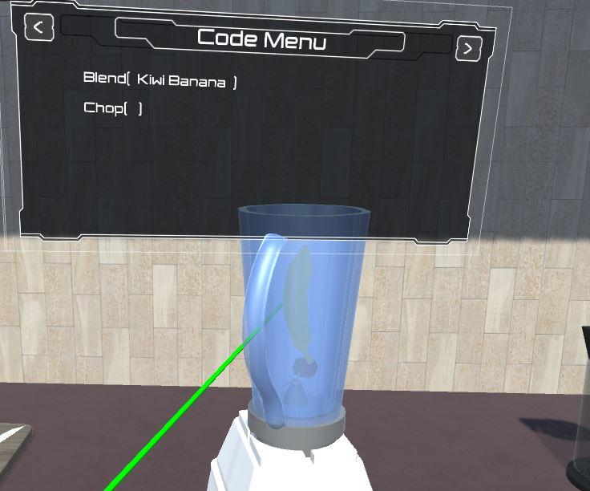
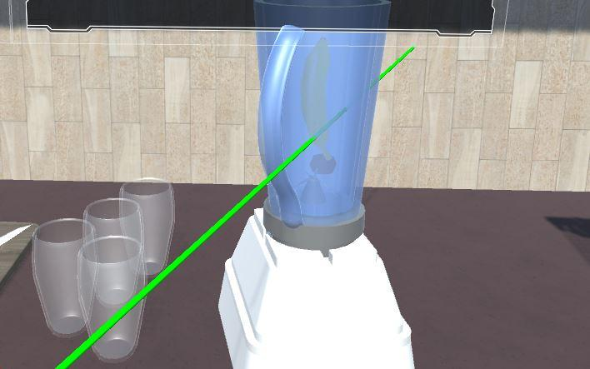
User Story #1114 - View looping functionality
Blender containing fruits placed on the platform
Glasses placed on the platform

Slide 33
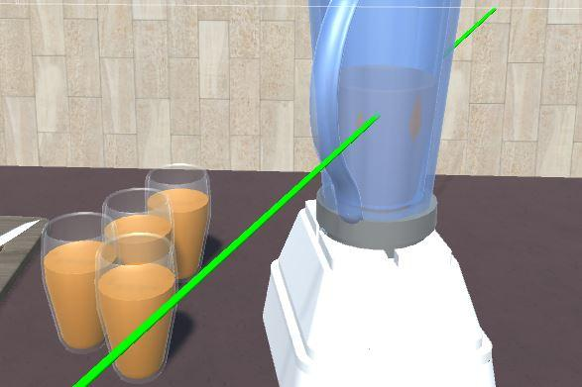
User Story #1114 - View looping functionality
Display is updated with the loop and the blending process is carried out
Juice in the blender is emptied and the glasses are filled out

Slide 34
User Story #1109 - Add button to begin animations
Description: Once a stoveObject has been placed on the stove, enable the button that correspond to the line of text that has been assigned to the stoveObject.
What does this mean?
When the stoveObject enters the stove’s trigger, the code for the stoveObject will be displayed in the Code Menu. During this user story, we also enabled a button that would serve as the initiator of the cooking process for the corresponding stoveObject.
Notes:
20 seconds
The tile of user story
Please present and show the complexity of your work, code, algorithms, and technical challenges and technologies you have used. (you could use screenshot if you want. Visual presentations are better than text presentation) - Go into the details of the most important/significant tasks using bullet lists or visual graphs or state chart diagram - Demo using screenshots or GIF (in another separate page if required)
Sequence Diagram for this user story is optional

Slide 35
User Story #1109 - Add button to begin animations
Why is this important?
Allows us to show the user output for the functions.
Animations will start only when the user is ready and presses the button.
Start the specified cooking function in contrast to start all cooking functions available.
Notes:
20 seconds
The tile of user story
Please present and show the complexity of your work, code, algorithms, and technical challenges and technologies you have used. (you could use screenshot if you want. Visual presentations are better than text presentation) - Go into the details of the most important/significant tasks using bullet lists or visual graphs or state chart diagram - Demo using screenshots or GIF (in another separate page if required)
Sequence Diagram for this user story is optional

Slide 36
User Story #1109 - Add button to begin animations
Challenges:
As default, Unity input is made from keyboard and mouse. We had to figure out how to include the wand as another input method.
Assigning the correct cook function.
Making sure that the button got assigned a function on runtime as opposed to assigning a function before running the game.
Making sure that the button was not retaining the function once the item left the stove.
Notes:
20 seconds
The tile of user story
Please present and show the complexity of your work, code, algorithms, and technical challenges and technologies you have used. (you could use screenshot if you want. Visual presentations are better than text presentation) - Go into the details of the most important/significant tasks using bullet lists or visual graphs or state chart diagram - Demo using screenshots or GIF (in another separate page if required)
Sequence Diagram for this user story is optional

Slide 37
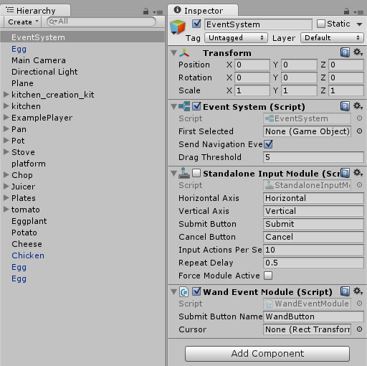
User Story #1109 - Add button to begin animations
In order for the wand to be the input when pressing the button, an EventSystem object had to be added to the Hierarchy. Then, we had to disable Standalone Input Module and add the Wand Event Module script as a component.
Notes:
20 seconds
The tile of user story
Please present and show the complexity of your work, code, algorithms, and technical challenges and technologies you have used. (you could use screenshot if you want. Visual presentations are better than text presentation) - Go into the details of the most important/significant tasks using bullet lists or visual graphs or state chart diagram - Demo using screenshots or GIF (in another separate page if required)
Sequence Diagram for this user story is optional

Slide 38
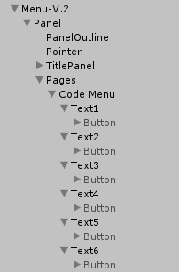
User Story #1109 - Add button to begin animations
This Code Menu contains six available lines of text. Each line of text contains, as a child, a Button. When the application starts, the buttons are disabled. Once the code from the stoveObject is passed on to the Code Menu, the button is enabled. However, the button will not carry out any function when clicked if there is no foodItem in the stoveObject.
Notes:
20 seconds
The tile of user story
Please present and show the complexity of your work, code, algorithms, and technical challenges and technologies you have used. (you could use screenshot if you want. Visual presentations are better than text presentation) - Go into the details of the most important/significant tasks using bullet lists or visual graphs or state chart diagram - Demo using screenshots or GIF (in another separate page if required)
Sequence Diagram for this user story is optional

Slide 39
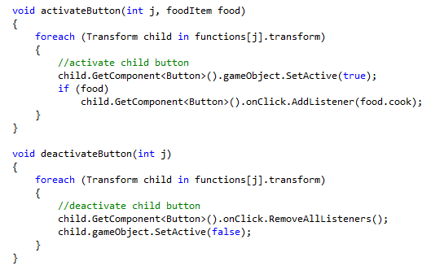
User Story #1109 - Add button to begin animations
When a stoveObject collides with the stove, activateButton is called. If this stoveObject has a foodItem in it, the cook function of this foodItem will be passed on the button. It does not affect
the application negatively not to have a foodItem already in the stoveObject because once a foodItem is placed in it, the function is called again in order to add the function to the button.
Notes:
20 seconds
The tile of user story
Please present and show the complexity of your work, code, algorithms, and technical challenges and technologies you have used. (you could use screenshot if you want. Visual presentations are better than text presentation) - Go into the details of the most important/significant tasks using bullet lists or visual graphs or state chart diagram - Demo using screenshots or GIF (in another separate page if required)
Sequence Diagram for this user story is optional

Slide 40
User Story #1109 - Add button to begin animations
Once the foodItem is removed, from the stoveObject, or the stoveObject is removed from the stove, deactivateButton is called. This removes the functionality of the button
to avoid any unwanted cooking function taking place.
Notes:
20 seconds
The tile of user story
Please present and show the complexity of your work, code, algorithms, and technical challenges and technologies you have used. (you could use screenshot if you want. Visual presentations are better than text presentation) - Go into the details of the most important/significant tasks using bullet lists or visual graphs or state chart diagram - Demo using screenshots or GIF (in another separate page if required)
Sequence Diagram for this user story is optional

Slide 41
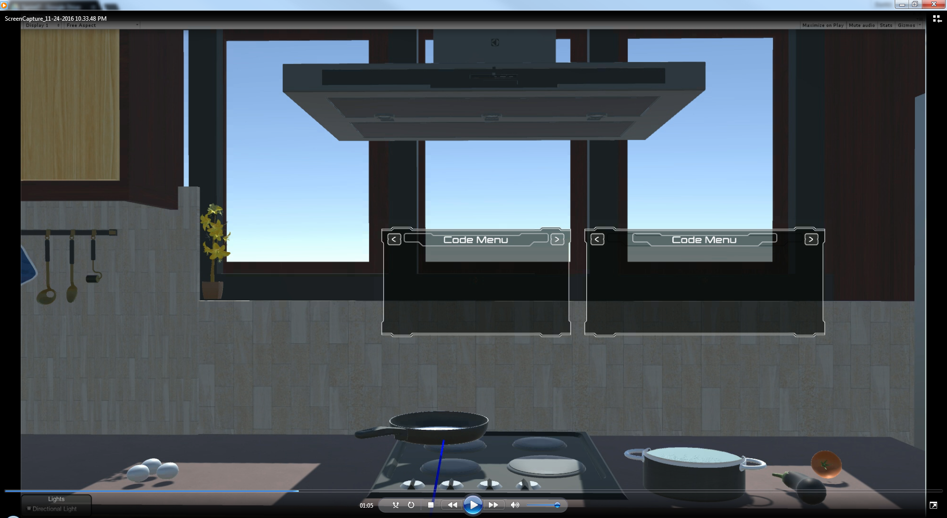
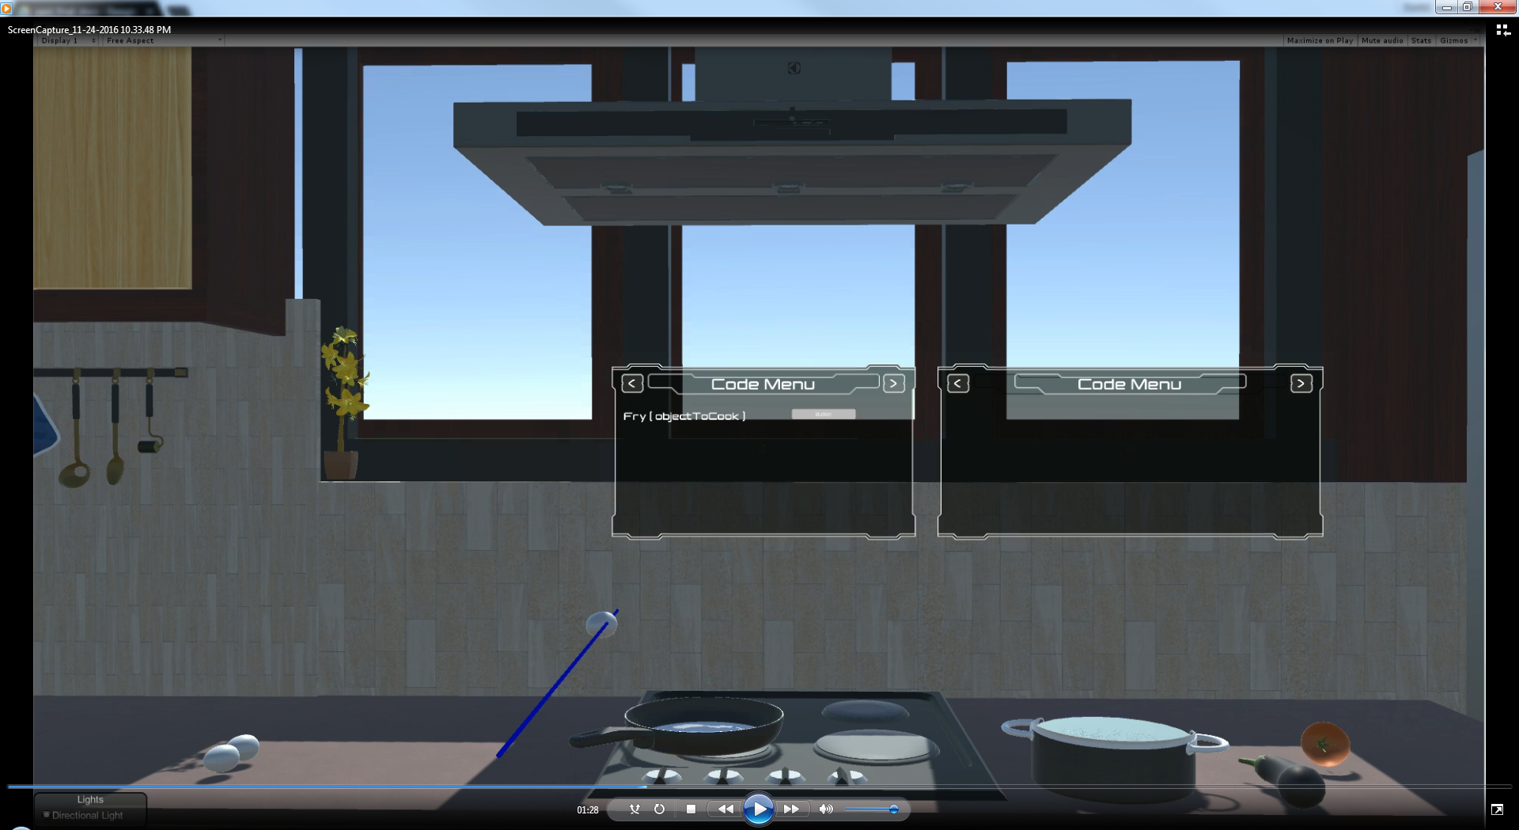
User Story #1109 - Add button to begin animations
Button enabled after placing pan on stove. After the egg is dropped on the pan, the pressing the button will carry out the cook function for the egg.
Notes:
20 seconds
The tile of user story
Please present and show the complexity of your work, code, algorithms, and technical challenges and technologies you have used. (you could use screenshot if you want. Visual presentations are better than text presentation) - Go into the details of the most important/significant tasks using bullet lists or visual graphs or state chart diagram - Demo using screenshots or GIF (in another separate page if required)
Sequence Diagram for this user story is optional

Slide 42
Test Cases for User Story #1087 - See object/parameter that the function is using
Test Case 1 - Update Code Menu when a foodItem enters a stoveObject’s trigger (Sunny day)
Test Procedure:
Using the GrabbingWand, grab the foodItem.
Place it above the stoveObject that it already on top of the stove.
Drop the foodItem inside the stoveObject.
Notes:
10 seconds
A description of verification process and Test Suites and Test Cases for one of the use cases.
1 One sunny day and one rainy day for the implemented use cases (one or more slides).
2 Automated test scripts for the implemented use cases (if any) (one or more slides).

Slide 43
Test Cases for User Story #1087 - See object/parameter that the function is using
Test Case 1 - Update Code Menu when a foodItem enters a stoveObject’s trigger (Sunny day)
Expected Result:
foodItem will enter the trigger of the stoveObject.
The Code Menu will be correctly updated and will display the correct code.
Results: Pass
Notes:
10 seconds
A description of verification process and Test Suites and Test Cases for one of the use cases.
1 One sunny day and one rainy day for the implemented use cases (one or more slides).
2 Automated test scripts for the implemented use cases (if any) (one or more slides).

Slide 44
Test Cases for User Story #1087 - See object/parameter that the function is using
Test Case 2 - Update parameter of function for non-cookable foodItem (Rainy day)
Test Procedure:
Using the GrabbingWand, grab the foodItem.
Place it above the stoveObject that it already on top of the stove.
Drop the foodItem inside the stoveObject.
Results: Pass
Notes:
10 seconds
A description of verification process and Test Suites and Test Cases for one of the use cases.
1 One sunny day and one rainy day for the implemented use cases (one or more slides).
2 Automated test scripts for the implemented use cases (if any) (one or more slides).

Slide 45
Test Cases for User Story #1087 - See object/parameter that the function is using
Test Case 2 - Update parameter of function for non-cookable foodItem (Rainy day)
Expected Result:
foodItem will enter the trigger of the stoveObject.
The Code Menu will be correctly updated and will display the correct code.
Results: Pass
Notes:
10 seconds
A description of verification process and Test Suites and Test Cases for one of the use cases.
1 One sunny day and one rainy day for the implemented use cases (one or more slides).
2 Automated test scripts for the implemented use cases (if any) (one or more slides).

Slide 46
Summary
Code by Cooking lays a foundation for introductory programming courses in virtual reality by immersing students in an environment that attempts to simplify programming concepts. The application’s purpose is to educate and to stay away from traditional teaching methods: a teacher, a blackboard, and some text. We hope that this application encourages education systems to incorporate new technologies into teaching.
Notes:
10 seconds
Summarize your contribution, mention your effort for Scrum, Mingle, Github, Google Drive Documentation and minutes
Include your contact information
Ask if anyone has any questions for you.
Thank your audience

Slide 47
Contact Information
Name: Derrick Serbia Email: derrick.serbia@gmail.com Phone Number: 305-725-1094
Name: Dhrumel Shah Email: dhrumelshah20@gmail.com Phone Number: 386-383-5380
Notes:
10 seconds
Summarize your contribution, mention your effort for Scrum, Mingle, Github, Google Drive Documentation and minutes
Include your contact information
Ask if anyone has any questions for you.
Thank your audience

Slide 48
Questions?
Notes:
10 seconds
Summarize your contribution, mention your effort for Scrum, Mingle, Github, Google Drive Documentation and minutes
Include your contact information
Ask if anyone has any questions for you.
Thank your audience

Slide 49
Thank You!
Notes:
10 seconds
Summarize your contribution, mention your effort for Scrum, Mingle, Github, Google Drive Documentation and minutes
Include your contact information
Ask if anyone has any questions for you.
Thank your audience

